Slide 1
TB16 DAPA ER TB16 DAPA API ER TB16 EOAP & Jupyter ER
TB16 DGGS & DGGS API ER
Panagiotis (Peter) A. Vretanos (CubeWerx Inc.) Luis Bermudez (GeoSolutions Group)
Christophe Noel (Spacebel)
117th OGC Member Meeting
Virtual | December 2020
Notes:
<number>

Slide 2
Introduction
This presentation will present material from three related engineering reports.
OGC Testbed-16: Data Access and Processing ER
OGC Testbed-16: Data Access and Processing API ER
OGC Testbed-16: Earth Observation Application Packages with Jupyter
OGC Testbed-16: DGGS & DGGS API ER
The first two are obviously related.
The third is related to the other two because it used Jupyter Notebooks accessing DAPA endpoints. These Jupyter Notebooks were then used as application packages to be deployed at an ADES.
The fourth is related because it overlays the DAPA API on top of a DGGS API.
<number>
Notes:
This slide present the problem DAPA is trying to address and how is addresses it.

Slide 3
OGC Testbed-16: Data Access and Processing ER
OGC 20-016

Slide 4
Table of Contents
List of participants
The problem
The DAPA solution
Coupling collections and processes
Spectrum of processing in the OGC
Previous Work
Use cases
Architecture
Jupyter Notebooks
DAPA Endpoints
Data Formats
Comparing DAPA and ADES
Was DAPA any good?
Future work
Notes:
This is the table of contents from the ER in the order that will be presented in the slide deck.

Slide 5
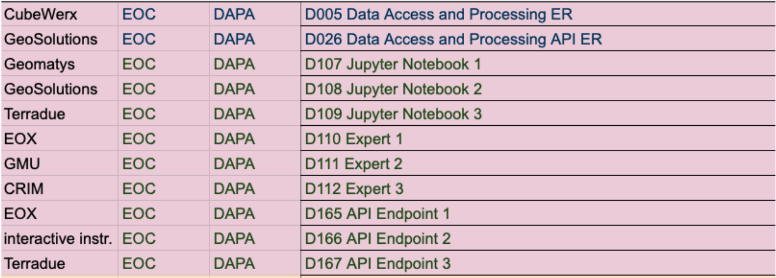
DAPA Participants & Deliverables
<number>

Slide 6
The problem
In the past APIs were designed from the perspective of the data provider which resulted in a less than optimal experience from the end-user perspective.
For example, to an end-user accessing a single provider deploying OGC API Processes and OGC API Features, which process can operate on the data in which feature collection is not obvious.
Furthermore, invoking processes is not straight-forward or user friendly using OGC API Processes requiring a JSON document be posted to an execution endpoint.
Also makes invoking a process within environments like Jupyter, while not impossible, may not be as easy as it could be.
General APIs sometimes offer too many options in terms of available processes, parameters that those processes take, etc. further obfuscating the capabilities of the server from the end-user.
<number>
Notes:
This slide present the problem DAPA is trying to address and how is addresses it.

Slide 7
The DAPA solution
Tightly couple the process with the data it operates on
Focused functionality that is specifically tailored to the needs of the intended end-users.
Using an invocation pattern consisting of GET with query parameters; a pattern familiar to anyone who has followed a link in a web page.
This makes it more convenient for use in environments like Jupyter
This also implies providing HTML output of the relevant resources so that an end-user can navigate the resources and invoke processes using just a browser.
<number>
Notes:
This slide present the problem DAPA is trying to address and how is addresses it.

Slide 8
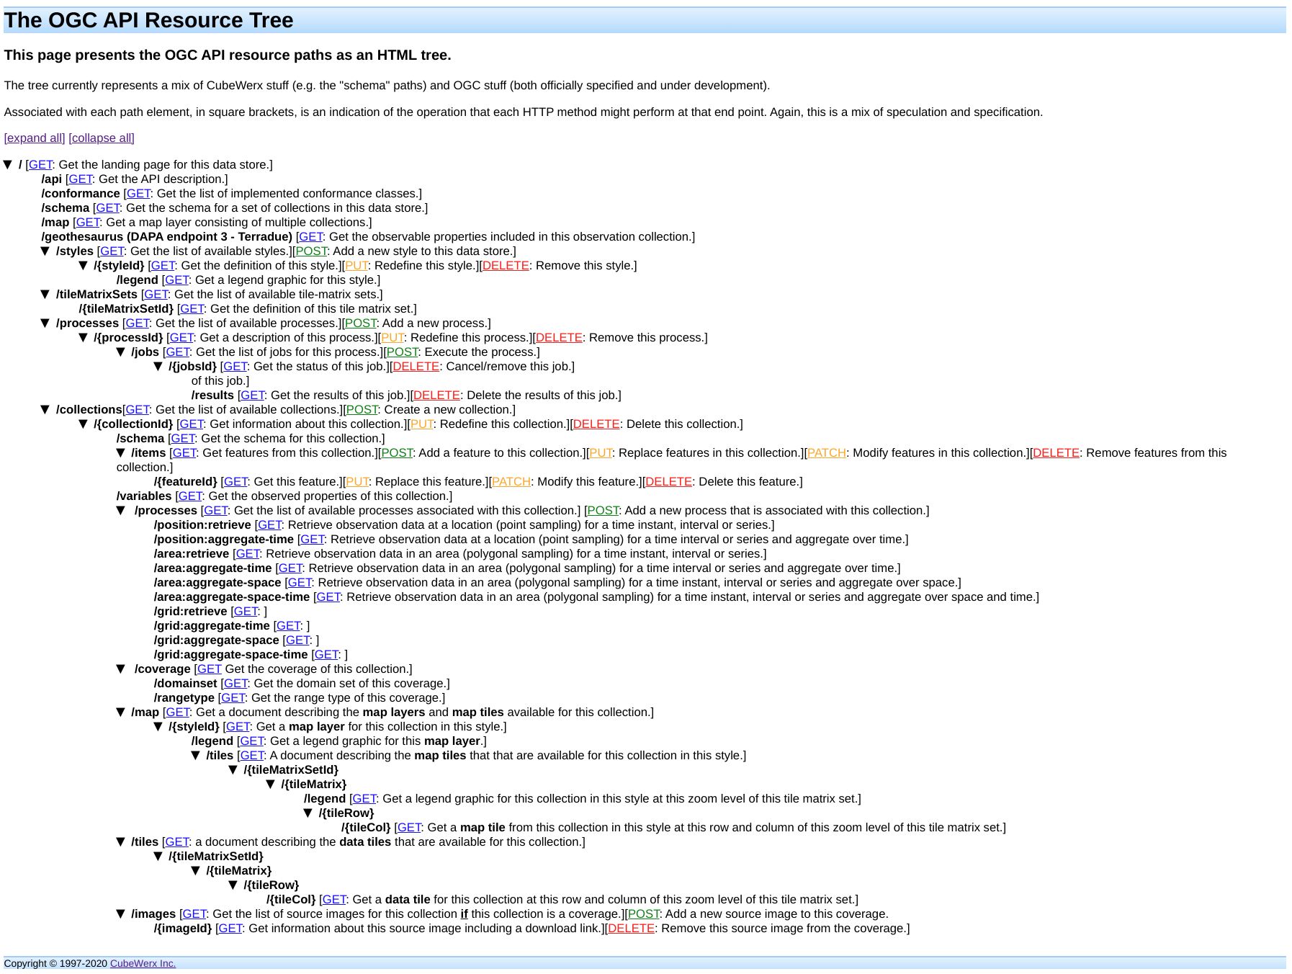
Coupling collections and processes
<number>
Notes:
This slide links out to the OGC API Resource tree to show where DAPA fits.

Slide 9
Spectrum of processing in OGC
Processing within the OGC can be viewed as a spectrum…
Where does DAPA fit in this spectrum?
DAPA and other APIs (e.g. EDR) built for communities of interest where rich, integrated functionality and ease-of-use are important.
We sometimes call these “convenience APIs” in OGC.
Specialized processing deem generally important with dedicated APIs (e.g. Maps, Routing)
OGC API Processes that enabled any process to be deployed on the Web.
<number>
Notes:
Within OGC there is a “spectrum” of process from the most general at the left to the most specific at the right.
At the left we have OGC API Processes that allows any process at all to be deployed on the web and invoked using a standard interface.
At the right we have OGC API – Maps and OGC API Routes which have been deemed by the membership to be “important” processes and for which a custom APIs have been designed
In the middle we have a class of processes that are important to a specific group of people. The APIs in this range are built taking into account functional requirements and easy of use of the community for which they are designed.

Slide 10
Previous work
The ER reviews existing best practices for both APIs and data encodings
The ER looks at the following previous API work
OpenEO
GeoTrellis
GeoAPI
Existing OGC APIs
The ER includes a very brief discussion about data formats
Although the topic was not covered that thoroughly in during the Testbed
<number>
Notes:
Refer audience to the ER to get more details about each of the listed APIs.

Slide 11
Use cases
The ER covers the use cases that participants articulated to drive the development of their DAPA endpoints and Jupyter Notebooks
Use cases fell into two categories:
Category 1: Use cases intended to evaluate the DAPA endpoints
either crawling the endpoint and testing each leaf node
comparing 2 or more of the endpoints
Category 2: Performing some sort of analysis
NO₂ tropospheric column between March/April 2019 and March/April 2020
<number>
Notes:
The use cases explored during the testbed fell into two categories as listed on the slide.

Slide 12
Architecture
The thread architecture was very straight forward...
<number>

Slide 13
Jupyter Notebooks
The ER provides a detailed description of the notebooks developed during the test bed with link to live, executable versions.
The notebooks performed the following analyses:
A notebook that crawled the resource tree of each DAPA endpoint
A notebook that compared the Terradue, EOX and ii endpoints
A notebook to compare NO₂ tropospheric column between March/April 2019 and March/April 2020 using Sentinel-5p data
<number>
Notes:
The ER provides a brief overview of what a Jupypter note is.
It then described each of the Notebooks developed for the testbed.
The notebooks fell into two classes: (a) analysis and (b) comparison of DAPA endpoints.

Slide 14
DAPA endpoints
The ER provides a detailed description of EOX, ii and Terradue endpoints.
The TB-16 DGGS and DGGS API ER described the GeoSolutions endpoint.
There were four endpoints deployed in the DAPA thread and in the DGGS thread: EOX – data cube, interactive instruments - scatter data, Terradue – gridded or coverage data (Sentinel-5p), GeoSolutions - Data in DGGS (from the DGGS thread)
The type of information in the ER about each endpoint includes:
The data sets deployed by each endpoint
A brief description of the API implemented by each endpoint
The deployment infrastructure
Any other salient implementation details
<number>

Slide 15
Data formats
Generally speaking less emphasis was placed on data formats in the thread.
The formats generated based on the type of data being accessed:
Coverage Data: GeoTIFF
Vector features: GeoJSON
Timeseries: CSV or JSON
Scalar values: plain text or JSON
<number>

Slide 16
Comparing DAPA and ADES
The ER includes a comparison of DAPA and OAPIP/ADES
The comparison was performed across the following axes:
Discovery – How process, inputs and output can be discovered in each API?
DAPA uses OpenAPI to completely describe a process
ADES uses a bespoke process description language for OGC API Processes
Data Coupling – Encoding relationship between a collection and processes?
For DAPA the relationship is encoded into the path for invoking the process.
For ADES, each processes would need to have an input parameter defined with an enumerated list of values.
Job Control – How jobs are invoked, monitored or cancelled?
DAPA is synchronous and has no job control per se.
ADES has a fully functional job control capability including the ability to monitor and cancel a running job.
<number>

Slide 17
Comparing DAPA and ADES
Invocation – How a process is invoked in the API?
DAPA uses and very simple URL with query parameters to invoke a process
ADES uses a JSON execute request POSTed to an execution endpoint.
Response – How are responses handled and retrieved?
DAPA only support synchronous execution and so results are provided in response to a request.
ADES has the ability for synchronous request-response operation but is also provides a richer set of capabilities for generating multiple results and retrieving each result.
Examples – A set of DAPA requests were recast into ADES requests to illustrate how each API would invoke the same process.
CONCLUSION: methods.
<number>

Slide 18
Comparing DAPA and ADES
CONCLUSIONS
OAPIP would benefit for having a simpler invocation pattern
See: https://github.com/opengeospatial/ogcapi-processes/issues/96
Having “transportable” endpoints would allow processes to be coupled to the resources upon which those processes operate
The “processes” sub-tree could be attached as a sub-resource to the resource upon which the processes operate
<number>

Slide 19
Was DAPA any good?
To get the answer to this question, a 5-day evaluation workshop was help in July 2020
Invited experts where asked to use DAPA and evaluate it based on:
Learning curve of the API
Richness of accessible functionality
Amount of code needed to execute some common analyses
The details of the workshop are described in the ER
BASIC CONCLUSIONS:
All the main evaluation criteria where achieved
More user friendly output formats
i.e. output formats compatible with popular processing libraries like GDAL
There were a number of other recommendations
See the Future Work slides
<number>

Slide 20
Future work
DAPA extensions
Add ability to negotiate output format
Add ability to specify spatial and temporal (aggregation) resolution on which processes should be executed
Add ability to pre-filter items that go into the processing functions
On-the-fly transformation of attributes
e.g. ...&fields=NDVI=(B04-B08)/(B04+B08),NDBI=(B01-B02)/(B01+B02))&…
Cross references values from other collections
e.g. ...&fields=(NDVI=(B04-B08)/(B04+B08))*(extCollection:CLOUD_MASK))&…
The ability to combine different data sets in one request
e.g. fusion of Sentinel-1 and Sentinel-2 for a specific point in time
Add ability to specify upscaling/downscaling of data to control volume being processes (see similar feature in Google Earth Engine)
<number>

Slide 21
Future work
Data
Define a set of possible output data type structures
data cube, coverage, time server, multi-dimensional data set, feature or simple value).
Define standard encodings for each output data type structure identified
e.g. GeoTIFF, GeoJSON, etc.
If they don’t already exist, create MIME types or MIME type templates that capture the valid combinations of data structure and encoding format(s).
Invocation of DAPA processes
Explore the possibility of using HTTP POST to invoke a process
I believe they mean using URL-encoded forms for longer length input parameters
<number>

Slide 22
Future work
Extensibility of the DAPA
See ADES
Documentation
Add INTERACTIVE documentation accessible directly from the API
The documentation should describe all aspects of a DAPA deployment
Paths, parameters, example invocations, etc.
Consider borrowing some capabilities from Google Earth Engine
<number>

Slide 23
OGC Testbed-16: Data Access and Processing API ER
OGC 20-025

Slide 24
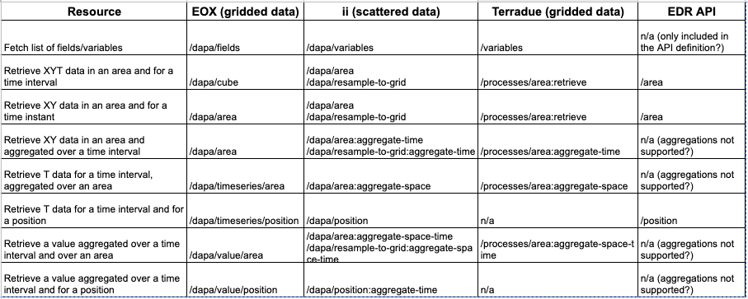
Various Developments

Slide 25
General Considerations
The Data Access and Processing API (DAPA) is a set of OGC API building blocks that operate on a Collection with observation data.
Each observation is associated with a point in space (2D or 3D) and time.
The spatial and temporal aspects may be regular (e.g. gridded) or scattered.
Observed properties may be available at each spatiotemporal point or they may vary from point to point.
All DAPA requests retrieve a subset of the observations. Data retrieval in DAPA is based on the selection of the observations by a spatial sampling geometry, the temporal sampling geometry, and the observed properties.
With DAPA requests offer a capability to aggregate the selected observations for each selected spatial point (aggregate over time), for each selected temporal point (aggregate over space) or for all selected observations (aggregate over space and time).
If follows a similar approach to the design advanced by the Environmental Data Retrieval API (EDR API SWG) approach of providing a separate resource, in this case "DAPA".
The DAPA endpoints will be available at /collections/{collectionId}/processes/{dapaProcessId}. More on the `dataProcessId`s and the endpoints below.
The observed properties will be available at /collections/{collectionId}/variables.

Slide 26
Data Access Considerations
Spatial sampling geometry
2d Point: Observations at a requested location (region of interest) are retrieved or interpolated. In general, the result is a time series for each available variable.
Query parameter coords: A Well Known Text (WKT) point geometry. Example: POINT(6.9299617 50.000008).
Query parameter coordsRef: A URI that returns a GeoJSON feature, such as a request to an API that implements OGC API - Features. If the feature geometry is not a point, the centroid should be used.
2d polygon or bounding box: Observations that intersect the sampling geometry are retrieved. The result is a time series for each variable. For gridded data, the result is a time series per grid cell and for scattered data the result is a time series for each location (e.g. each point).
2d grid: Observations in the grid area are retrieved and resampled to the grid. The result is a time series for each variable and each grid cell.
Temporal sampling geometry
The temporal sampling geometry is always provided in the parameter datetime. Use timestamps or dates. Intervals are expressed according to ISO 8601.
Time series: not implemented

Slide 27
Data aggregation and processing
Over time (for point, polygon or grid sampling geometries),
Over the whole area (polygon or grid sampling geometry), or
Both (polygon or grid sampling geometry).
If the temporal sampling geometry is an instant, aggregation over time operates on a single value.
The statistical functions to use on the set of values for each variable are provided as a comma-separated list in a query parameter functions.
The following identifiers are used for a core set of statistical functions:
Minimum value (min)
Maximum value (max)
Average/mean value (mean)
Standard deviation (std-dev)
Number of values (count)

Slide 28
The report captures three main approaches
Design 1 - More focused on the process
Design 2 - More focused on the output type
Design 3 - for DGGS

Slide 29
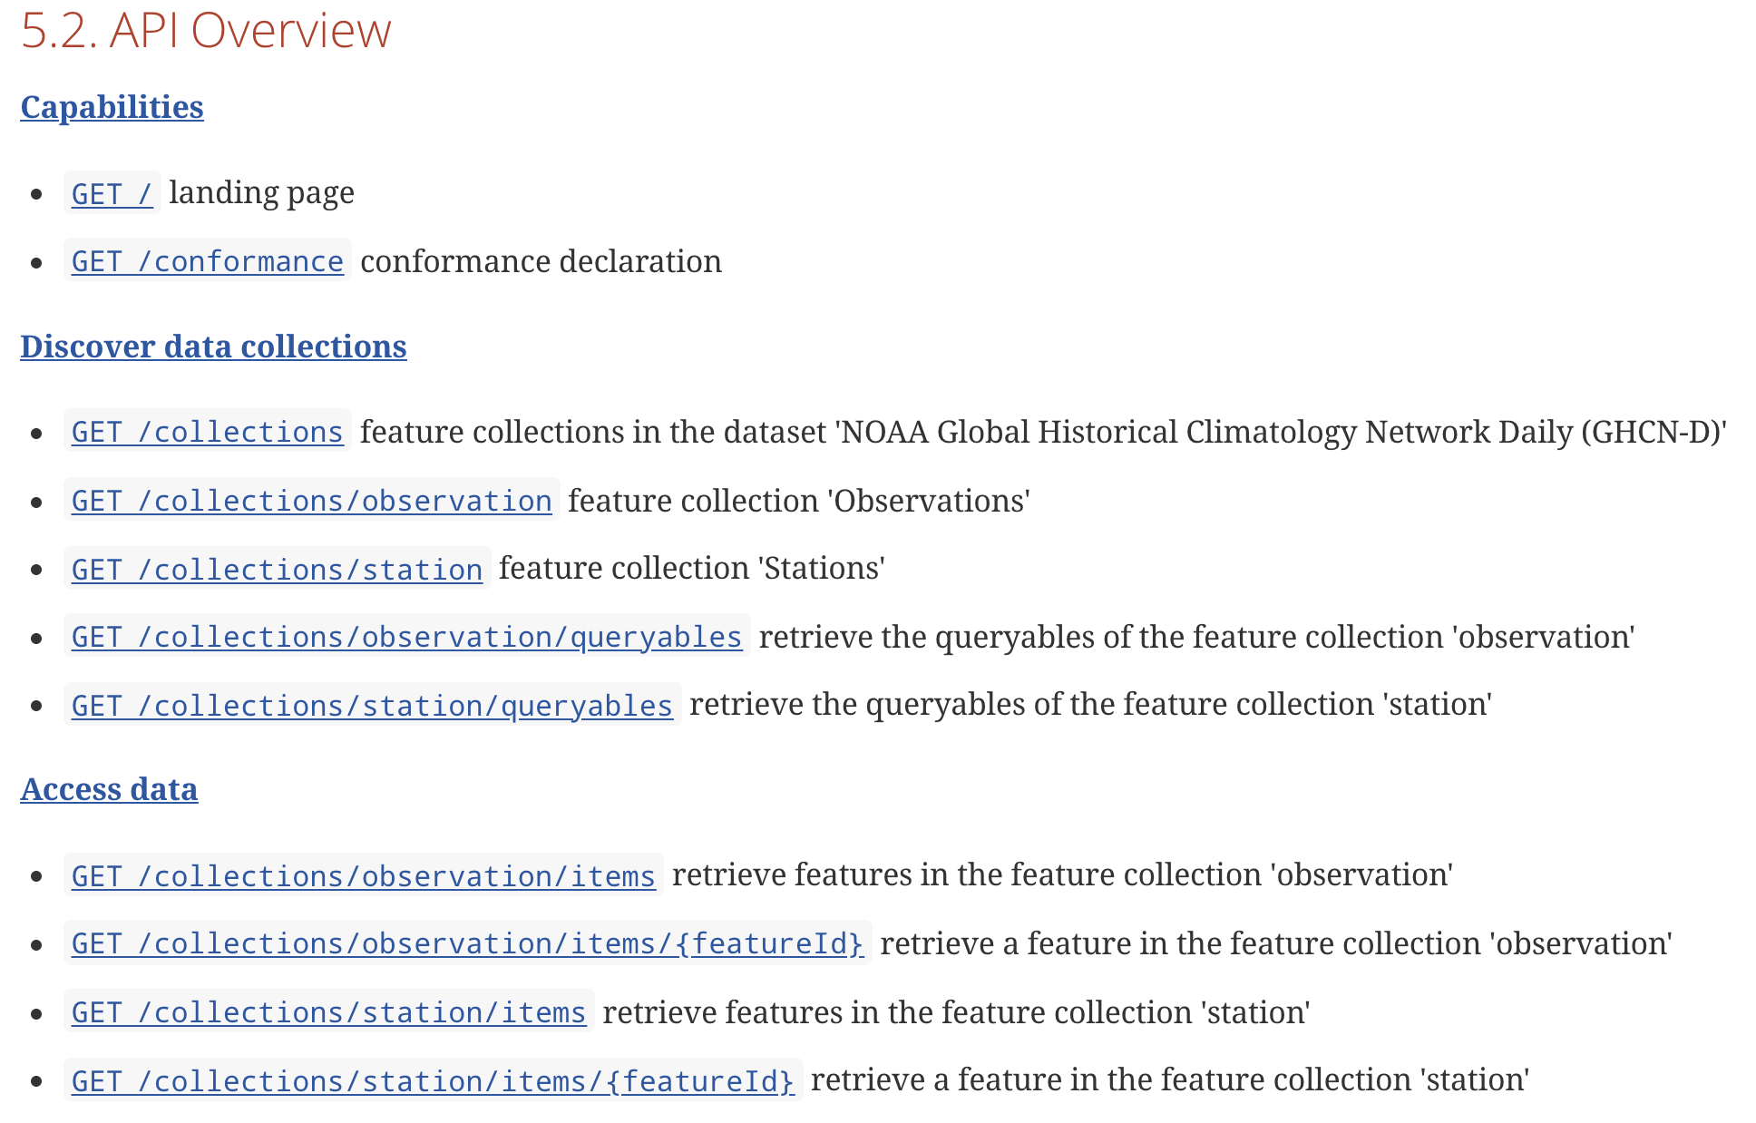
D1 – focused on the process

Slide 30
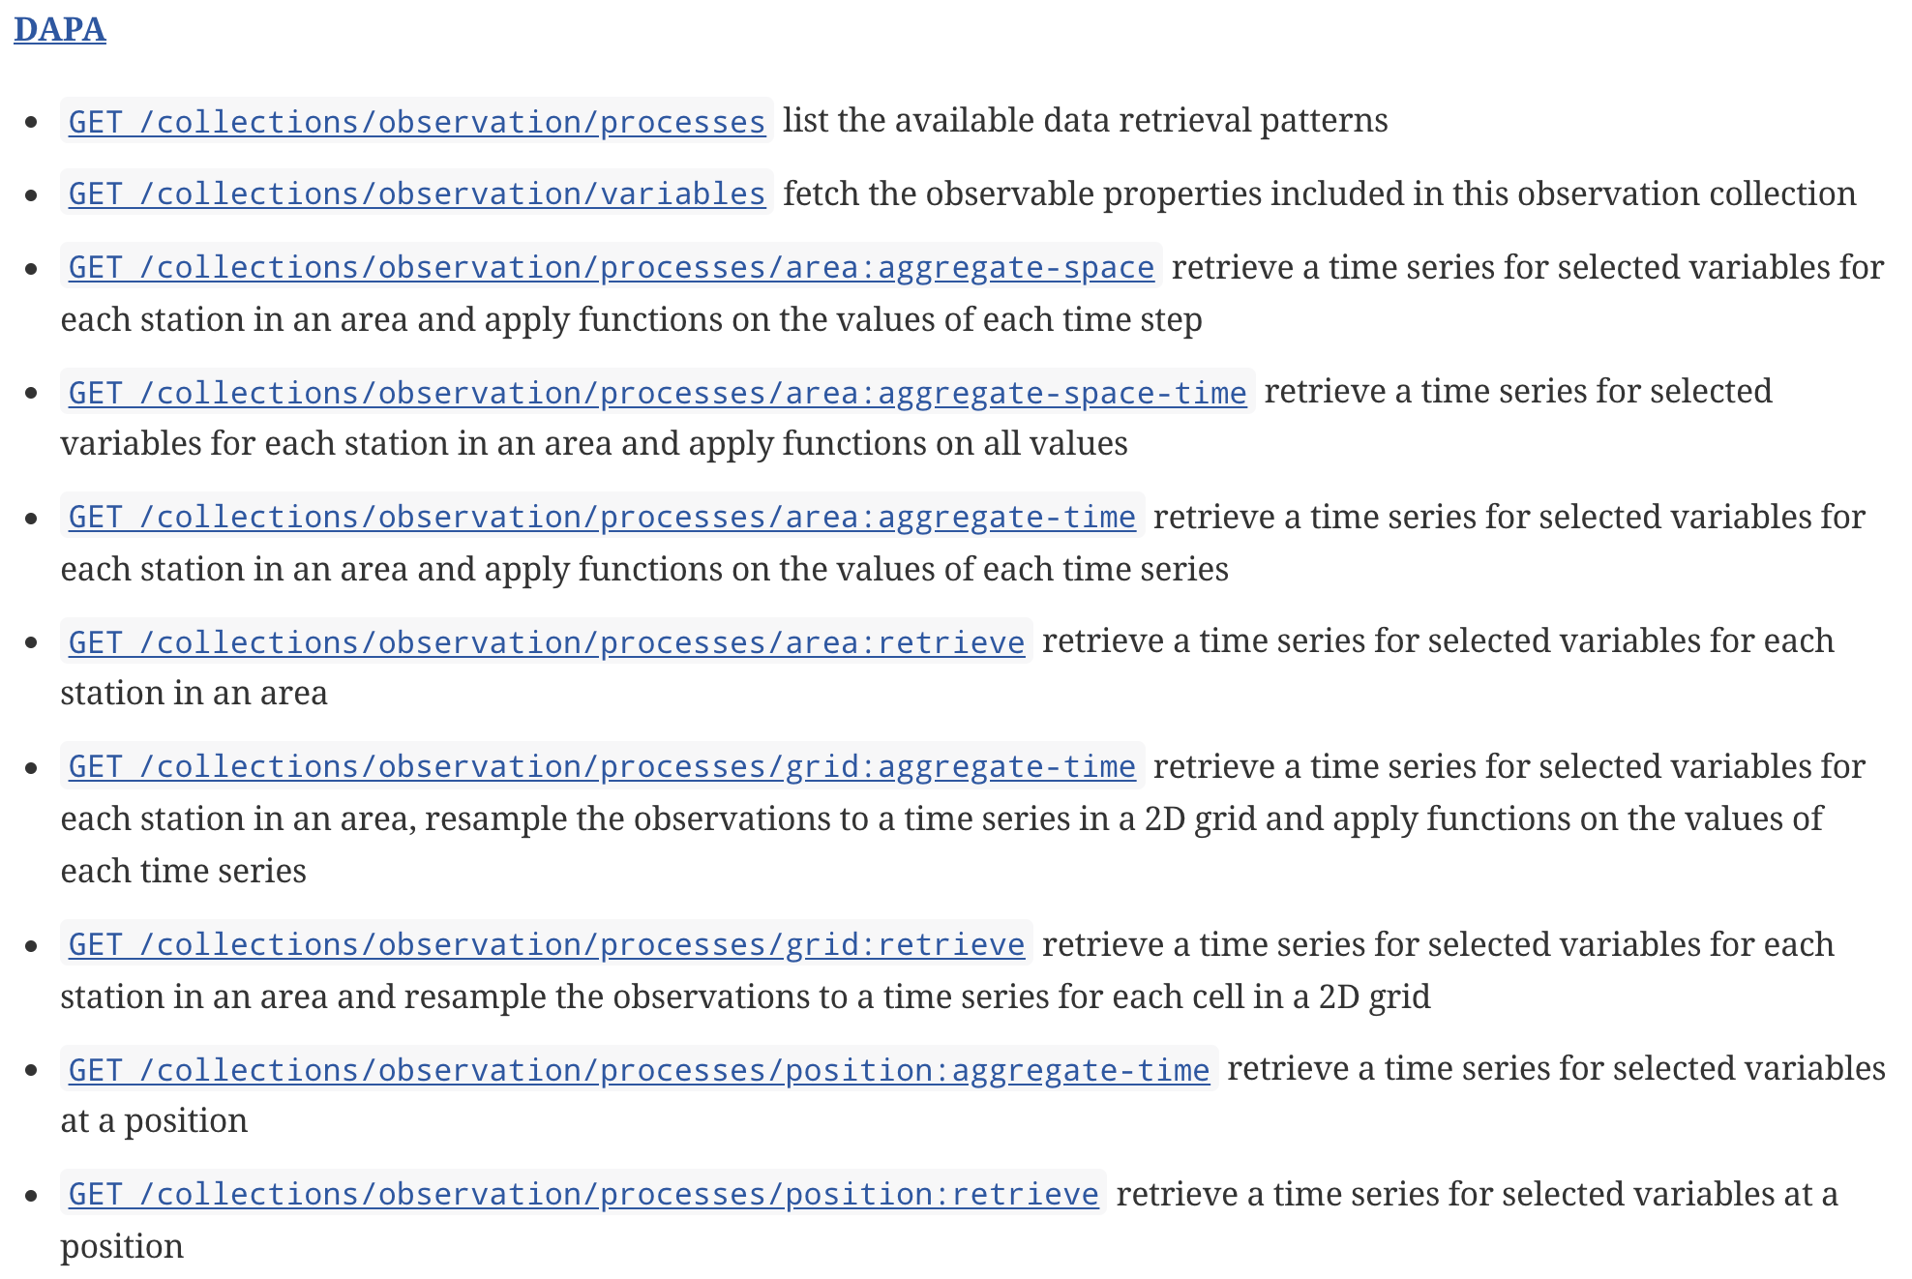
D1 – focused on the process

Slide 31
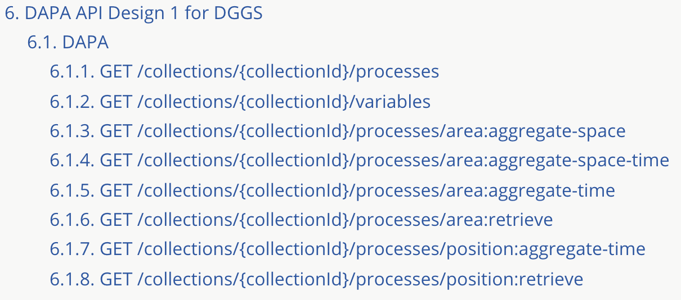
D2 – DGGS

Slide 32
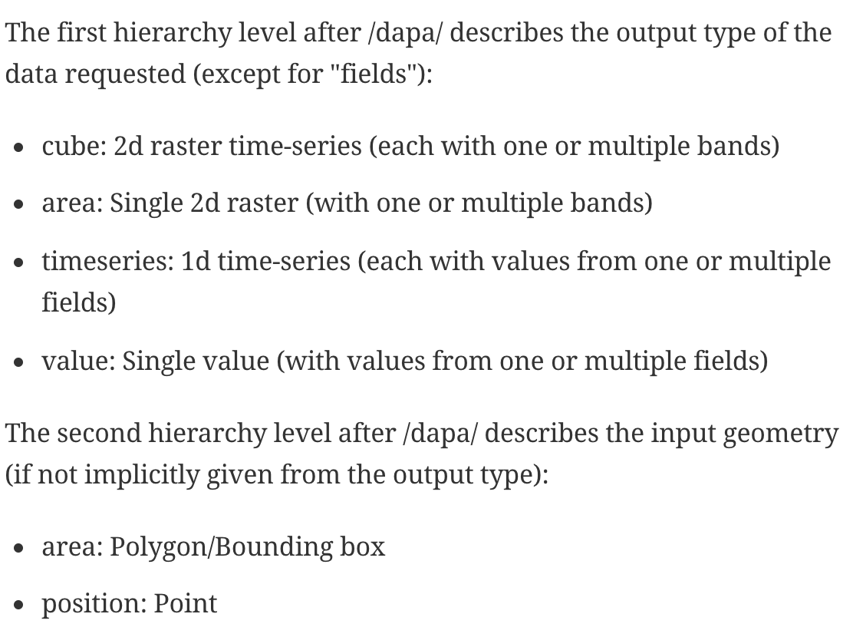
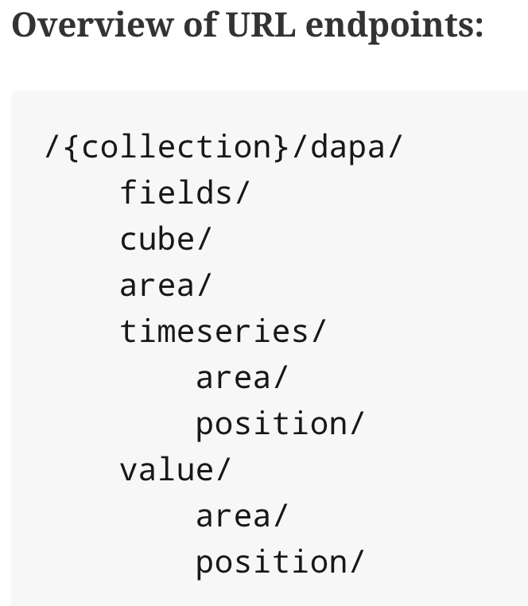
D3 – Focused on the output type

Slide 34
OGC Testbed-16: DGGS Server
OGC 20-035

Slide 35
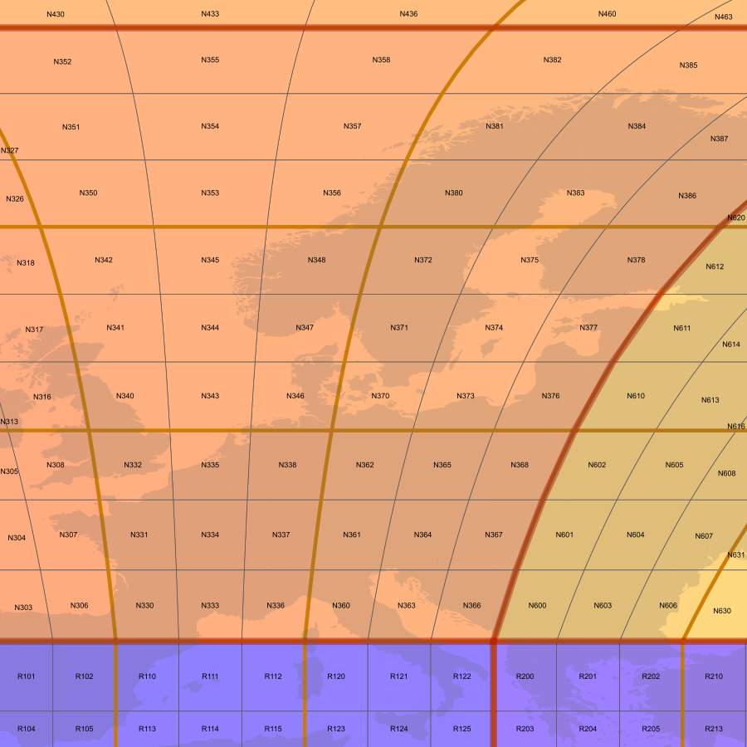
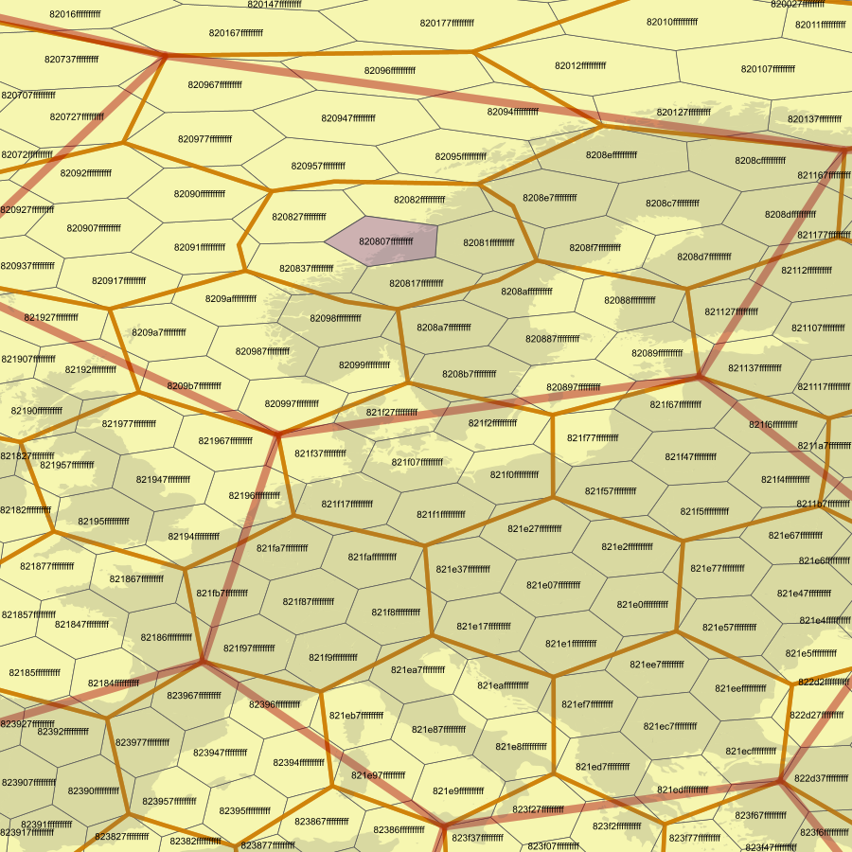
DGGS
Equal sampling areas
Global coverage
Poles and datelines are not “special”
Parent/child, neighborhood
Multi-resolution
rHealPix
H3 (areas similar, not equal)

Slide 36
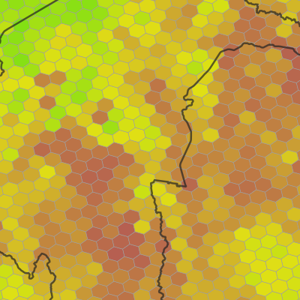
DGGS for analysis
Equal-area sampling at every scale
Pre-computed statistics
Just in time precision
* could have also pre-computed other aggregates

Slide 37
DGGS for analysis
Sampled at resolution 14
Zone parents computed by aggregation (fast)
Stored in ClickHouse OLAP database

Slide 38
DGGS based DAPA
Same methods as vector/raster DAPA (position, area, space/time aggregation)
Extra parameter: “resolution”. → Choose fast or accurate
Spatial filter, polygon or list of DGGS zones
Turned into ClickHouse queries
ClickHouse tables are partitioned (eventually distributed)
Query computation uses all cores/nodes
Especially fast if the spatial filter is expressed as a set of DGGS zones

Slide 39
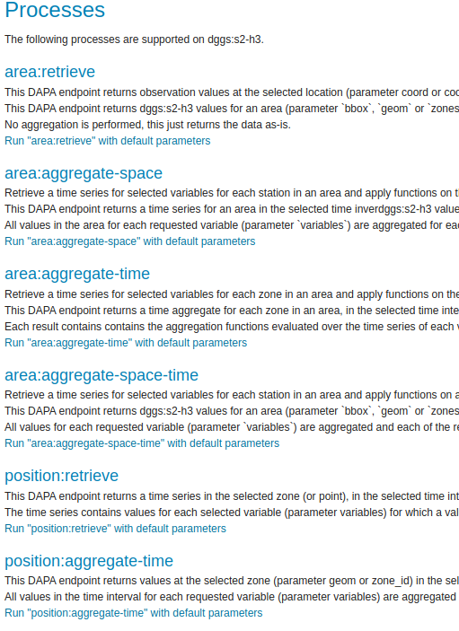
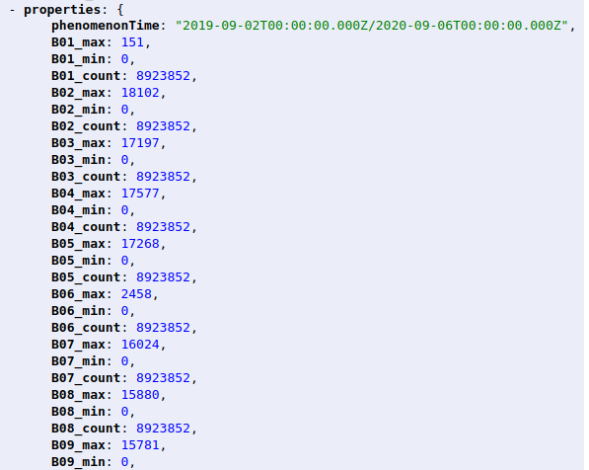
DGGS based DAPA
Space/time aggregation
8.9 million records aggregated in less than a second
On spinning disks (RAID)
https://tb16.geo-solutions.it/geoserver/ogc/dggs/collections/dggs:s2-h3/processes/area:aggregate-space-time?resolution=11&f=application%2Fgeo%2Bjson
https://tb16.geo-solutions.it/geoserver/ogc/dggs/collections/dggs:s2-h3/processes?f=text%2Fhtml

Slide 40
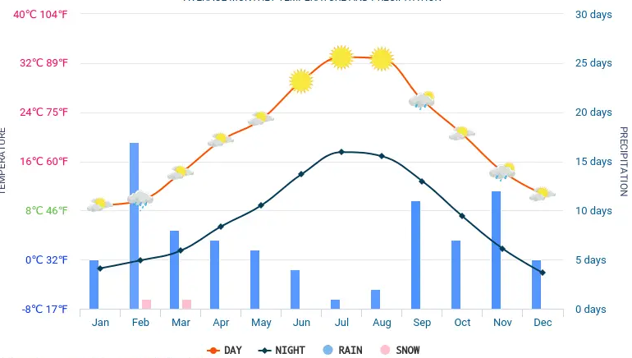
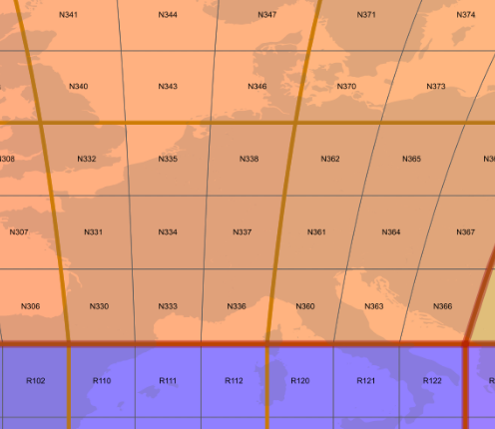
The DGGS server
Analysis
OGC API - DAPA
Data
ClickHouse
OLAP database
OGC API - DGGS
Data
DGGS relations
https://tb16.geo-solutions.it/geoserver/web/

Slide 41
OGC Testbed-16: Earth Observation Application Packages with Jupyter Notebooks
OGC 20-035

Slide 42
Project is about Jupyter Notebook…
A Notebook is an web-based interactive programming interface:
- Code can be edited
- Execution on the fly
Copyright © 2020 Open Geospatial Consortium
Notes:
First, the project is about Jupyter Notebook which is the technology explored in parallel by the DAPA task. A Notebook is a programming interface presented as a web application, in which the code parts are grouped in cells that you can edit and execute on the fly, and optionally showing the results as a graphical element on the page.
<number>

Slide 43
…And about the OGC EO XP Platform
Copyright © 2020 Open Geospatial Consortium
Notes:
The project is also about the OGC EO Exploitation Platform which can be quickly described as follows.
<number>

Slide 44
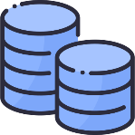
Before Earth Observation Cloud Platforms…
→ Download data and analyse on local system:
DATA
Customer
Local
Platform
Copyright © 2020 Open Geospatial Consortium
Notes:
Before the emergence of Cloud platform, customers had to download data to their local machine and then perform the analysis locally.
<number>

Slide 45
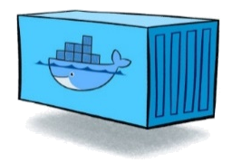
New EO Cloud Platforms…
→ Analysis close to the data (in the “Cloud”):
APPLICATION
PRODUCT
API
API
API
APP PROVIDER
APP CONSUMER
APP PROVIDER APP CONSUMER
Copyright © 2020 Open Geospatial Consortium
Notes:
The new platform as described by the OGC architecture shift the previous paradigm by providing APIs to application providers for deploying applications close to the data, and let potential application consumers execute the applications or subscribe to the generated products.
<number>

Slide 46
EO XP Platform + Jupyter
… what’s the interest ?
Copyright © 2020 Open Geospatial Consortium
Notes:
What our engineering reports tries to highlight is the asset of integrating Notebook into a Cloud architecture.
<number>

Slide 47
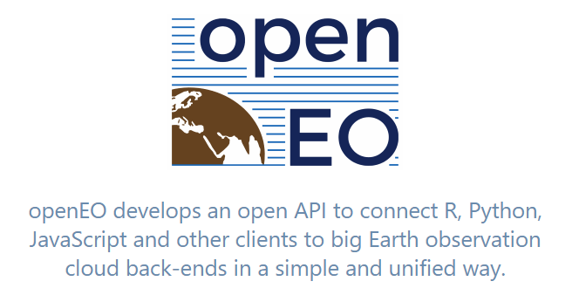
Benefit: Ease interactions with services
User-friendly libraries:
Kernel Libraries
OpenSearch
DAPA
WPS
CATALOGUE
USER
PROCESSING
DATA
Copyright © 2020 Open Geospatial Consortium
Notes:
First, obviously the Notebook can really ease the way the developers can interact with the platform services. With the condition of course to provide user-friendly libraries which can possibly be generated from the OpenAPI specification (using tools such as Swagger CodeGen). Another very interesting solution that we recommend to investigate is openAPI, an open API which is already promoted by ESA which funded the OpenEO platform.
<number>

Slide 48
Coverage access from Mundi DIAS Notebook
Copyright © 2020 Open Geospatial Consortium
Notes:
A number of platforms such as the Mundia DIAS provides such functionality as shown in this short video clip. The developer can easily create a coverage request by specifying the desired bounding box and then display the result as an image in the Notebook user interface.
<number>

Slide 49
Benefit: Development in the Cloud
Develop applications close to the data and services:
APPLICATION
API
PRODUCT
APP DEVELOPER
APP CONSUMER
Copyright © 2020 Open Geospatial Consortium
Notes:
A second substantial asset for the platform is to use the notebook and the offered libraries as an integrated development environment that enables developers to compose an application. The developer is able to interactively test the various steps of the application from the Cloud platform with the real data and services provided by the platform.
<number>

Slide 50
Jupyter Environment – Issues & Challenges
How to provision the Jupyter environment ?
How to share & collaborate ?
APP DEVELOPER
Copyright © 2020 Open Geospatial Consortium
Notes:
The engineering report tries addressing a few challenges for supporting notebooks: first, potential solutions for provisioning the environment, then also possible approaches for sharing notebook including collaborative work.
<number>

Slide 51
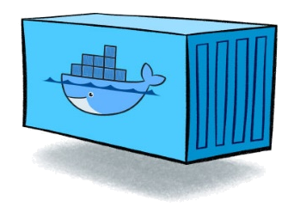
ADES packaging of Notebooks
ADES
API
APP PROVIDER
Container
Command-line
Copyright © 2020 Open Geospatial Consortium
Notes:
The participants resolved a critical step for extending the ADES component with Jupyter support: they demonstrated how to package a Notebook into a container and how to provide a command line interface for a batch mode execution by the ADES.
<number>

Slide 52
1. Docker Container from a Notebook
Copyright © 2020 Open Geospatial Consortium
Notes:
The build of container can be automated using the tool repo2docker which can create the relevant environment from a git repository containing the notebook, the environment configuration and optionally a Dockerfile. Note that the approach can be reused for any kind of applications that needs to be containerized, not only Jupyter Notebook.
<number>

Slide 53
2. Command-line from a Notebook (#1)
Papermill Approach:
Copyright © 2020 Open Geospatial Consortium
Notes:
The second step for building the ADES package requires to provide a command-line interface to the notebook which is originally based on an interactive web UI. This can be achieved easily using papermill and by providing the Application Descriptor which describes the inputs and outputs of the application.
<number>

Slide 54
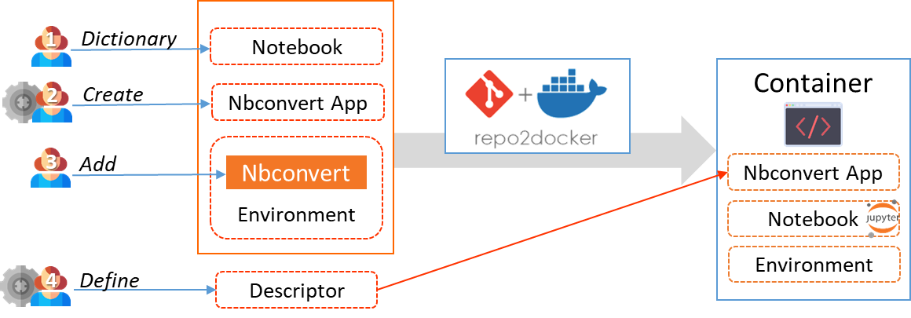
2. Command-line from a Notebook (#2)
Custom app (based on nbconvert) + Python dictionary:
Copyright © 2020 Open Geospatial Consortium
Notes:
An alterative approach showed that describing the inputs/outputs within the notebook in a python dictionary enables the automated generation of the Application Descriptor. Additionally, the alternative approach explored the possibility to create a command-line application based on nbconvert to control the batch execution of the notebook.
<number>

Slide 55
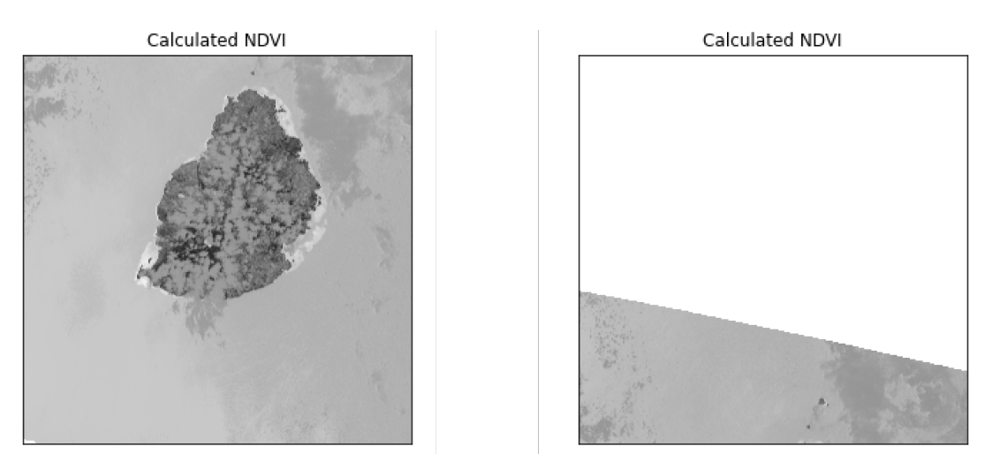
Processing Chains and Workflows from Notebooks
Copyright © 2020 Open Geospatial Consortium
Notes:
Participants also prototypes examples showing how easy Jupyter Notebook can be used for developing processing chains. Potentially, the libraries offered by the notebook can be use to easily develop workflows that combine data discovery, fetching, and chaining of available processes. This approach is a very interesting alternative to the complex build of chains using workflow language.
<number>

Slide 56
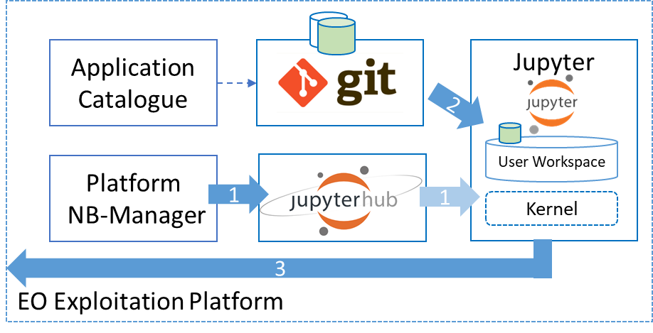
Future Work
Explore:
Remaining challenges from the CFP:
Support of interactive notebook
Sharing
Security
(automated build of the ADES package)
Notebook-based workflows
OpenEO libraries integration
ER – proposed Notebook support architecture
Copyright © 2020 Open Geospatial Consortium
Notes:
Focusing on the Jupyter Notebook aspects, first the remaining challenges from the CFP shall be pursued for support interactive notebook, the sharing, security, and of course the recommendations from the ER can help for going in that direction. Moreover, workflows based on notebook is probably a very interesting topic, and finally, the integration of the OpenAPI standard in notebooks would be an asset.
<number>

Slide 57
Motion
The EO Exploitation Platform recommends that the OGC Technical Committee approve release of OGC 20-016 - OGC Testbed-16: Data Access and Processing Engineering Report as a public OGC Engineering Report.
Pending any final edits and review by OGC staff
Motion: Chris Lynnes
Second:Cristiano Lopes, Joan Maso
Discussion: No discussion.
There was no objection to unanimous consent.
Copyright © 2020 Open Geospatial Consortium

Slide 58
Motion
The EO Exploitation Platform recommends that the OGC Technical Committee approve release of OGC 20-025 - OGC Testbed-16: Data Access and Processing API Engineering Report as a public OGC Engineering Report.
Pending any final edits and review by OGC staff
Motion: Chris Lynnes
Second: Pedro Gonçalves
Discussion: No discussion.
There was no objection to unanimous consent
Copyright © 2020 Open Geospatial Consortium

Slide 59
Motion
The EO Exploitation Platform recommends that the OGC Technical Committee approve release of 20-035 - Earth Observation Application Packages with Jupyter Notebooks Engineering Report as a public OGC Engineering Report.
Pending any final edits and review by OGC staff
Motion: Panagiotis (Peter) Vretanos
Second: Cristiano Lopes
Discussion: No. discussion.
There was no objection to unanimous consent.
Copyright © 2020 Open Geospatial Consortium

