Slide 1
OGC Interoperability Program Testbed-13 Earth Observation Clouds
Testbed-13 Demo Meeting
December 12-13, 2017
USGS National Center in Reston, VA

Slide 2
Earth Observation Clouds Thread
Support ESA’s Thematic Exploitation Platforms (TEP) by exercising envisioned workflows for algorithm deployment
Exercising workflows for data integration, processing, and analytics based on algorithms developed by users that are deployed in multiple clouds.
Define Application Package, upload this package to the Thematic Exploitation Platform (TEP), and deploy it on infrastructure that is provided as a service (IaaS) for testing and execution.
Engineering Reports:
Application Package (OGC 17-023)
Application Deployment & Execution Service (OGC 17-024)

Slide 3
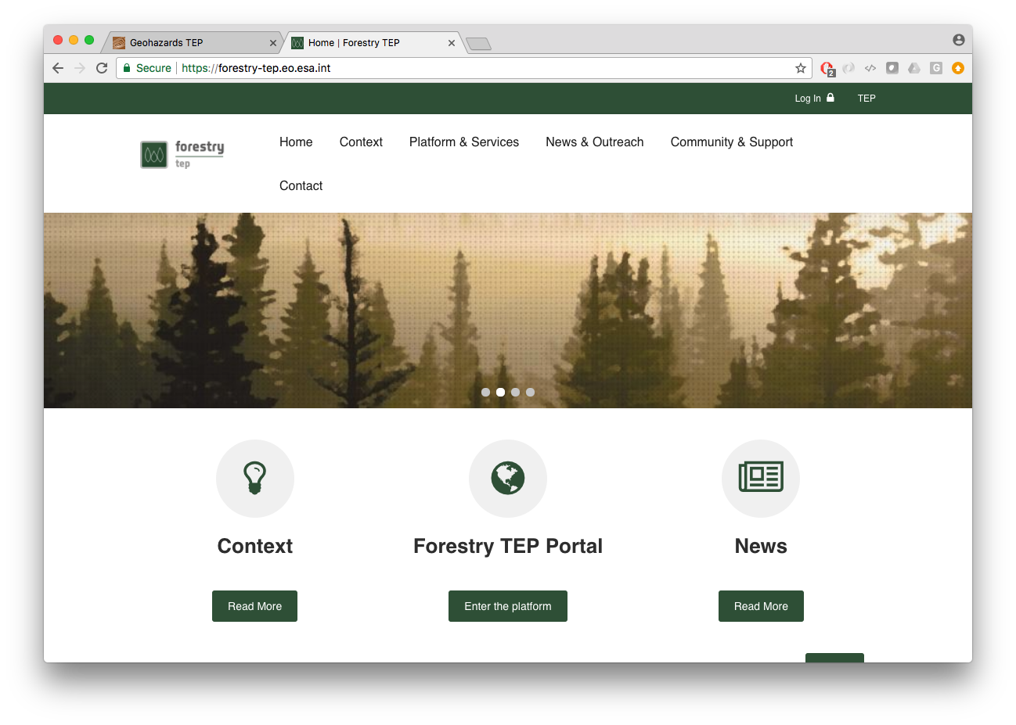
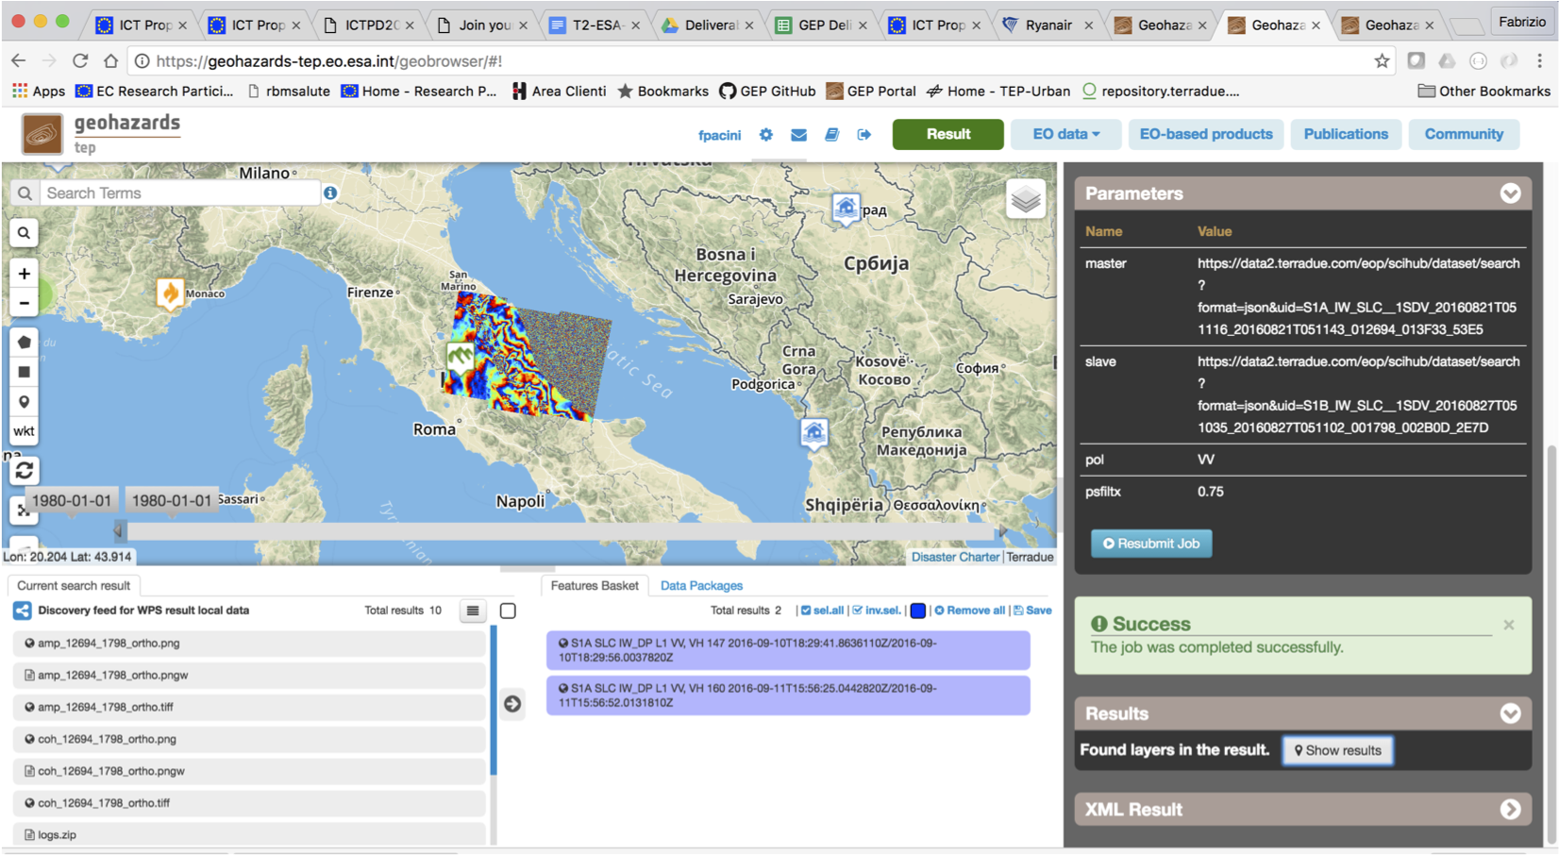
ESA Thematic Exploitation Platforms
An ecosystem of computing platforms aggregated around an Earth Science thematic area.
Define scenarios with data and ICT provision
Earth Observation data exploitation (user discovers and manipulates data)
New service development (user deploys a new processor)
New product development (user publishes new results)

Slide 4
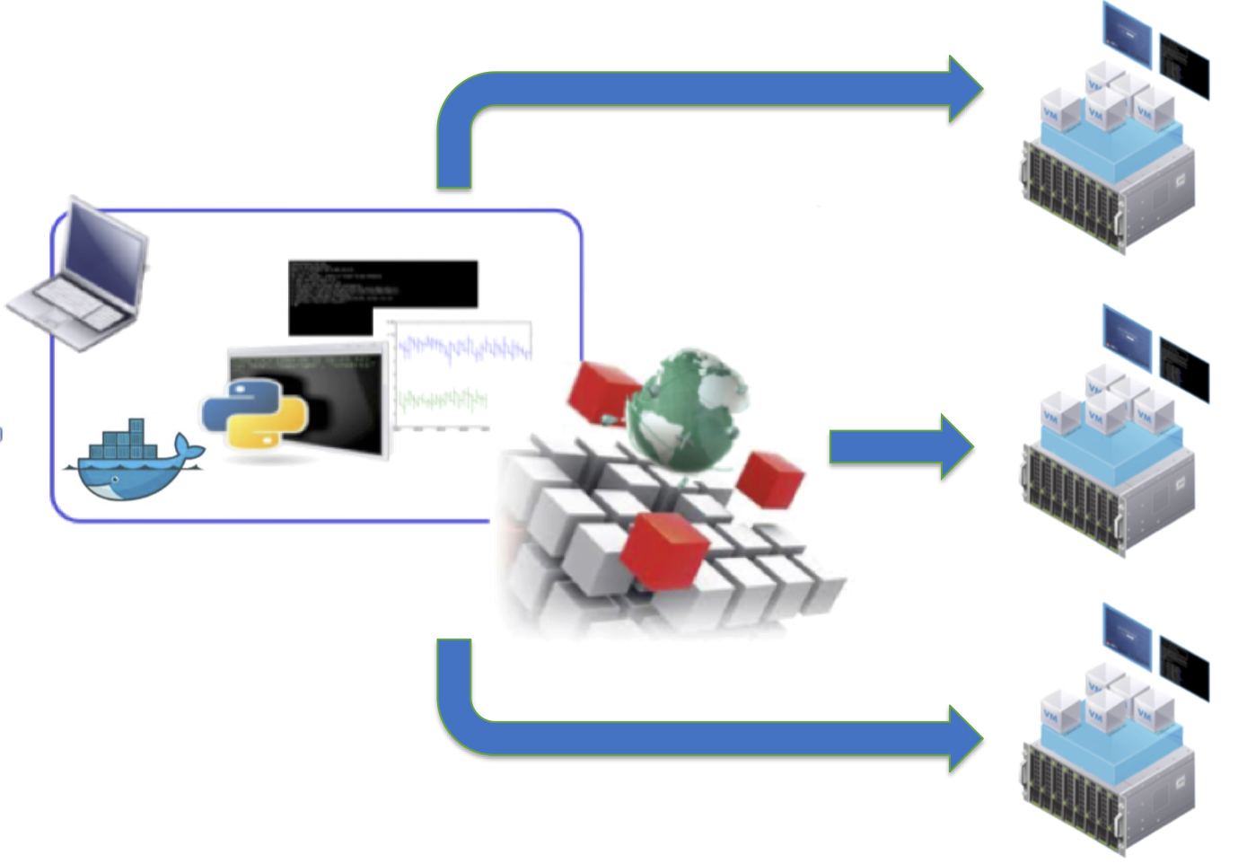
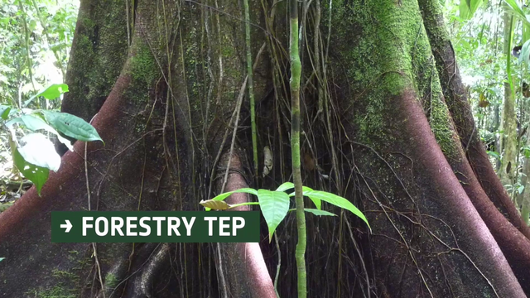
EOC Thread Activity
Identified a strategy for packaging an application in a Cloud environment that will be able to run in different computing production centres.
Applications were selected from the Forestry thematic exploitation platform and from the Geo hazards tep

Slide 5
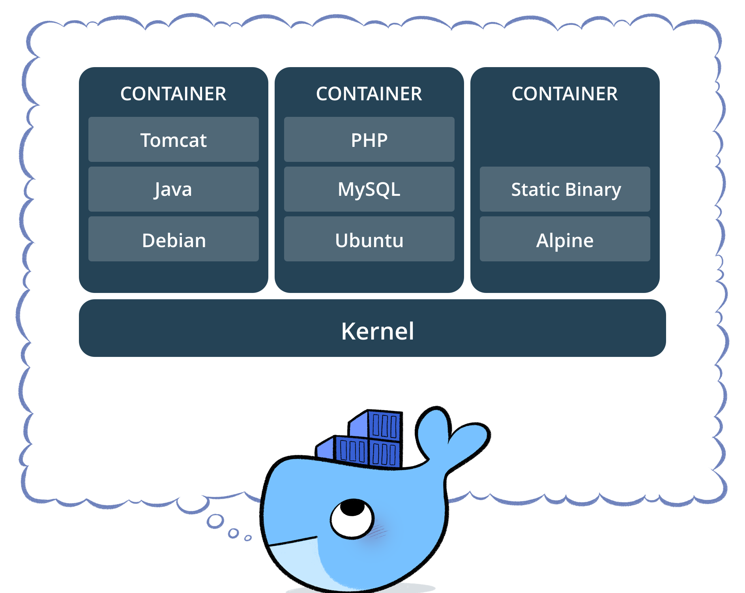
Application Package
The Application Package contains all the information necessary to allow applications to be specified and deployed
Consensus to use the OWS Context documents to convey
information about the Docker container providing a consistent environment for execution
WPS as the execution interface
information about the input data and respective OpenSearch catalogue end points
Used as input parameter to a dedicated WPS service that will create and deploy the application as a new WPS process offering
An alternate approach is also presented to derive an WPS process offering from the OWS Context for deployment on a transactional WPS

Slide 6
Application Package
Specific profile for the OWC Context Object at feed Level
The Application Package information model uses the ows:Resource class mapped to the atom:entry element to define each package element

Slide 7
Application Container
The application container information is mapped to a owc:offering with a specific code

Slide 8
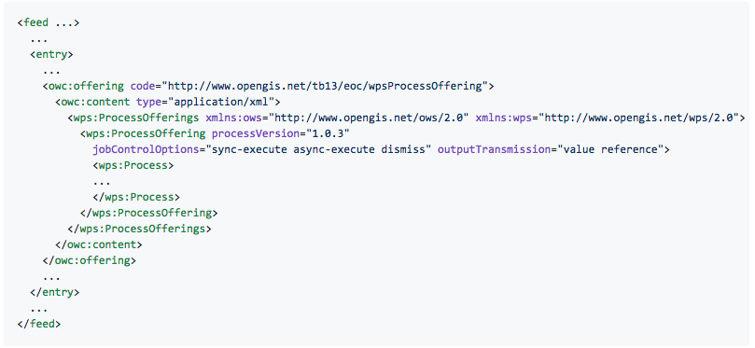
Application Parameters
The application parameters are conveyed by a WPS Description mapped to a owc:offering with a specific code

Slide 9
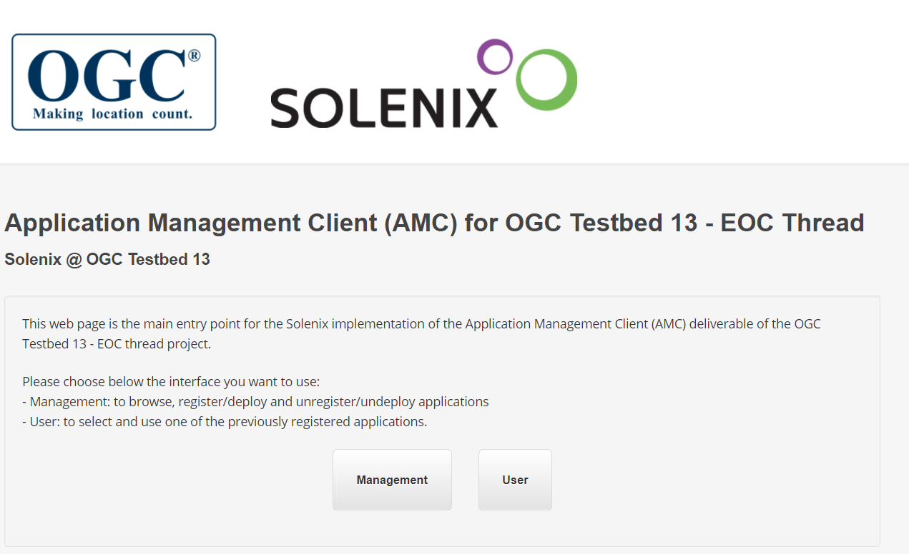
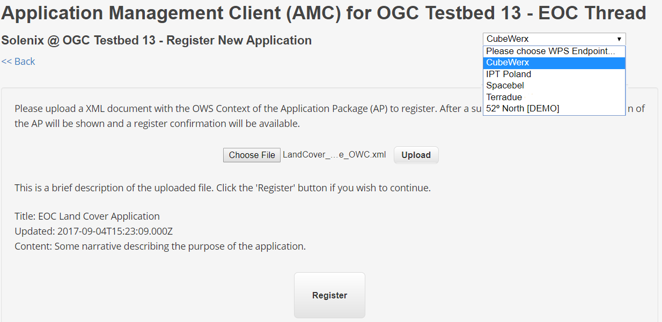
Application Management Clients
The OWS Document is used to deploy the application on a specific provider using different clients

Slide 10
Application Execution
The deployed applications appear as W P S process offerings
Executing a deployed application, is simply a matter of using the WPS Execute operation

Slide 11
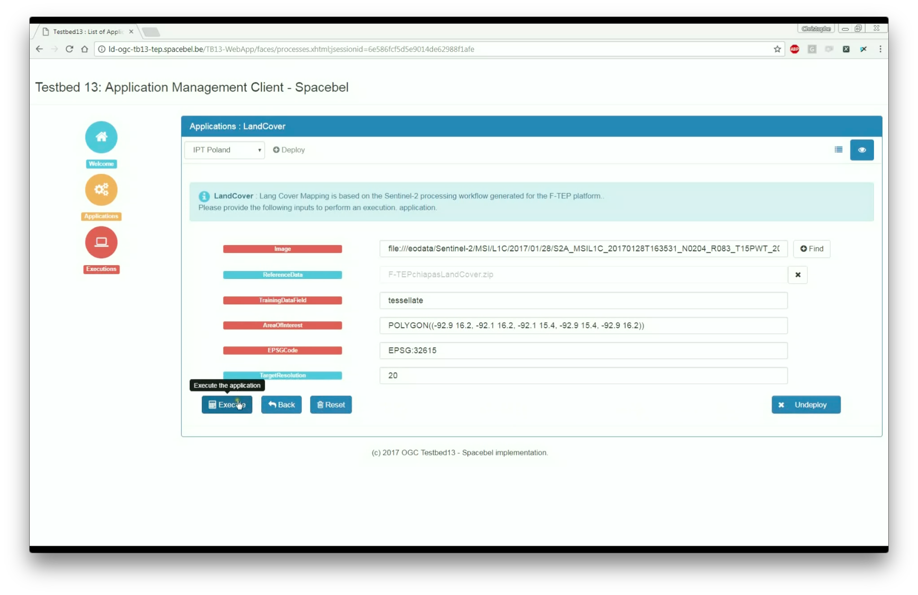
Application Execution Clients
Execution clients can list of possible inputs and submit the execution of the process on the selected platform

Slide 12
OWS Context Application Package
Encapsulates user applications and enables upload, deploy, run and sharing between platforms
The OWS Document conveys information :
Application metadata (like description and author)
Application container and resource types
Application parameters
Input data and respective catalogue resources
Auxiliary map resources to support both the parameters and discovery process
Information about output data
The goal of the exercise is to define a TEP Application Package taking in consideration past efforts on the OGC Web Services Context Document (OWS Context) and OGC Web Processing Service (WPS) as the means to integrate OGC services with well-established formats and protocols that are natively ready for interoperability within Cloud solutions.

Slide 13
OGC Interoperability Program Testbed-13 Earth Observation Clouds
Thank You !

